Slide 1
Making A Soft Slab Vase
presents:
Notes:
This project uses soft slabs to create an organic form as opposed to the hard slabs used in the previous project that produced a geometric form.

Slide 2
Make The Template
Making A Soft Slab Vase
Notes:
Circular templates can be purchased or made using string, a pencil, and poster board or tag board.

Slide 3
Stacking The Form
Play with parts to create the best form.
Making A Soft Slab Vase
Notes:
Students should make more forms than they need for their project. Place all the forms in the center of table so students can play with the parts to create the best combination.
Form Criteria:
Maximum height 12”
Minimum 4 parts
Each section has to change directions
A cylinder can be added as one part
When stacking the pieces, the diameter of one part should exactly fit the diameter of the adjoining part. If necessary students can create a cylinder as one of their pieces.

Slide 4
Make The Slabs
Roll and cut the slabs, then smooth both sides.
Making A Soft Slab Vase
Notes:
Place the cardboard shapes on a smooth clay slab and cut them out. Wrapping these clay parts to be ready for the next class can be tricky because the slabs need to be easy to shape but not wet. Don't store slabs on a stack of newspaper because they dry too quickly. Place the slabs in a plastic bag. Try to trap some air inside while making sure the bag is closed. If wrapping slabs this way leaves them too moist, include a single sheet of newspaper under the slab to wick away some moisture.

Slide 5
Bevel The Edges
Cut the ends at an angle.
Making A Soft Slab Vase
Notes:
Use the angle cutter or a table edge as a guide to cut a 45-degree angle. Remind students they have to cut one angle, then turn the slab over to cut the other one.

Slide 6
Attach The Template Forms
Score and slip the parts together.
Making A Soft Slab Vase
Notes:
Score and slip the angles well so they will stay firmly attached. Assemble each part. Wrap parts in a plastic bag to stay moist until the next class.

Slide 7
Clean The Edges
Making A Soft Slab Vase
Notes:
Use a surform, or by using a table top, tap the form to flatten tops and bottoms so they will fit together.

Slide 8
Assemble The Forms
Attach the forms together.
Making A Soft Slab Vase
Notes:
Score and slip to attach the pieces together. Once they are well attached, add a small moist coil to the seam. It is not necessary to work from the bottom to the top; it is more important to attach pieces that are stiff enough to support each other.

Slide 9
Practice Design
Draw your design on a scrap piece of clay.
Making A Soft Slab Vase
Notes:
Using a dull pencil or sgraffito tool, draw a zentangle design into the leather-hard clay.The drawing must create a deep groove to hold the underglaze, but not so deep that it will create a weak point, causing drying and firing cracks. For best results, Mishima lines should be parallel and not intersect.
Using the paintbrush, apply a dark underglaze into the lines.
Using a clean moist sponge, wipe away the excess underglaze. It’s very important to only use a clean sponge. Do not wipe an area twice using a dirty sponge; the design will smear and possibly disappear altogether.

Slide 10
Carve Design Into Vase
Draw your design on a scrap piece of clay.
Making A Soft Slab Vase
Notes:
Using a dull pencil or sgraffito tool, draw a zentangle design into the leather-hard clay. You must create a deep groove to hold the underglaze, but not so deep that it will create a weak point, causing drying and firing cracks. Mishima lines should be parallel and not intersect for the best results.

Slide 11
Apply Underglaze To Design
Paint black underglaze over your entire design.
Making A Soft Slab Vase
Notes:
Using the paintbrush, apply a dark underglaze into the lines.
Using a clean moist sponge, wipe away the excess underglaze. It’s very important to only use a clean sponge. Do not wipe an area twice using a dirty sponge; the design will smear and possibly disappear altogether.
Just before the clay is bone dry, the excess underglaze can be removed with a metal scraper.
Velvet Underglazes used: V-362 Jet Black
Learn more about Velvet Underglazes here: https://www.amaco.com/t/glazes-and-underglazes/underglaze/velvet-underglaze/velvet-underglazes#more

Slide 12
Clean The Rim
Making A Soft Slab Vase

Slide 13
Glazing pt. 1
Apply TP-22 Blue Green to the blank areas.
Making A Soft Slab Vase
Notes:
Make sure students wipe their pottery with a damp sponge before glazing the exterior.
Clear or tinted clear glazes work well over a Mishima design.
Use a solid opaque glaze like Teacher’s Palette on the plain parts and Teacher's Palette Light on the areas with Mishima.
To make sure the Mishima designs are not covered, try mixing Teachers Palette Light 50/50 with LG-10 Clear to produce a beautiful tinted clear glaze that will enhance the underglaze design without hiding it.
Glazes used: TP-22 Blue Green
Learn more about Teacher’s Palette glazes here: https://www.amaco.com/t/glazes-and-underglazes/low-fire/teachers-choice-and-palette

Slide 14
Glazing pt. 2
Apply TPL-44 Peridot to the Mishima design.
Making A Soft Slab Vase
Notes:
Make sure students wipe their pottery with a damp sponge before glazing the exterior.
Clear or tinted clear glazes work well over a Mishima design.
Use a solid opaque glaze like Teacher’s Palette on the plain parts and Teacher's Palette Light on the areas with Mishima.
To make sure the Mishima designs are not covered, try mixing Teachers Palette Light 50/50 with LG-10 Clear to produce a beautiful tinted clear glaze that will enhance the underglaze design without hiding it.
Glazes used: TPL-44 Peridot
Learn more about Teacher’s Palette glazes here: https://www.amaco.com/t/glazes-and-underglazes/low-fire/teachers-palette-light

Slide 15
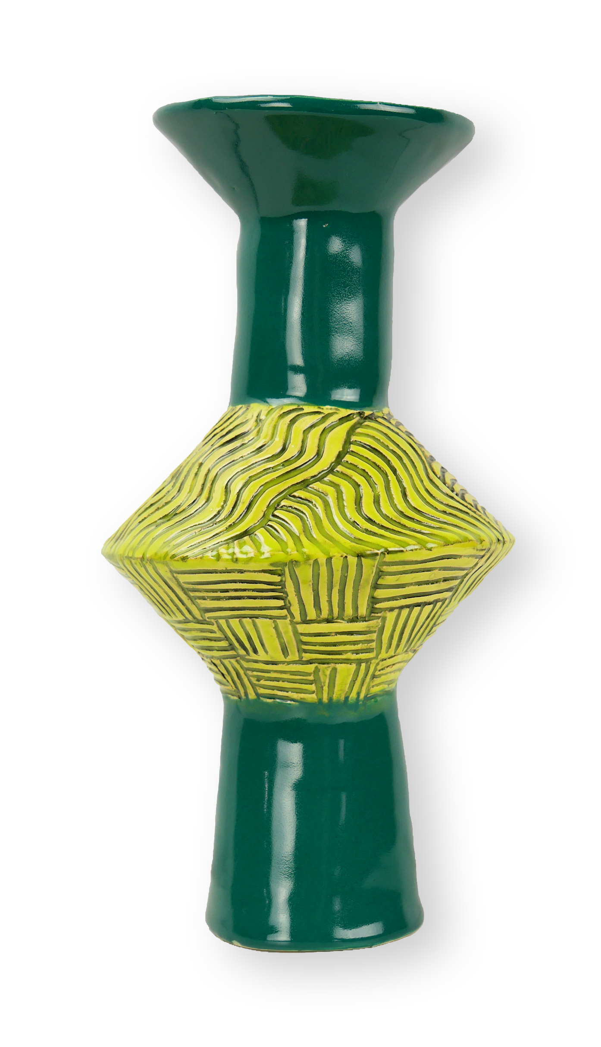
Final Piece
Making A Soft Slab Vase

