Slide 1
presents:

Slide 2
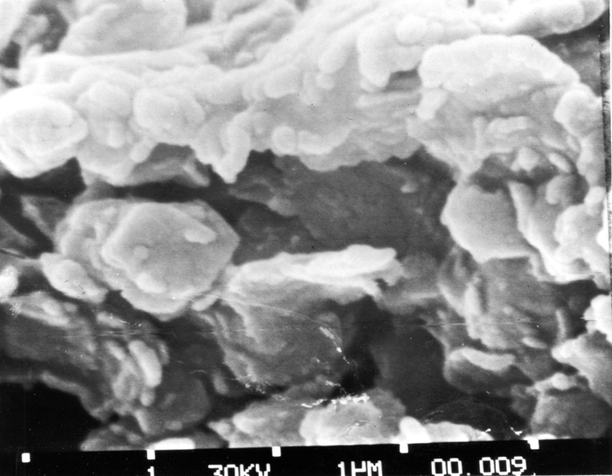
STAGES of CLAY
What exactly is clay?
Notes:
Teacher Notes: This is a microscopic photo of clay but what exactly is clay? Clay is made from feldspathic rock that over time breaks down through the movement of wind and water. This powder-like mixture, when added to water, makes the soft, malleable material that we know as clay.
Image Citation:
McKee. “ Scanning Electron Microscope Photograph of Smectite Clay - Magnification 23,500 - U.S. Geological Survey - Tuckup Canyon.” USGS Science for a Changing World, www.usgs.gov.

Slide 3
TERMS to KNOW
GREENWARE is unfired pottery.
A KILN is a type of oven that can fire pottery at high temperatures.
BISQUE-FIRING is the first firing in a kiln.
BISQUE-WARE is pottery that is fired one time.
GLAZE-WARE is pottery that has a shiny glass-like coating.
Notes:
Learning the following terms, and labeling shelves for greenware and bisque, will help students organize a kiln room.

Slide 4
THE 5 STAGES of CLAY
1. Wet Work
2. Leather-hard
GREENWARE
3. Bone Dry
4. Bisque
FIRINGS IN A KILN
5. Glaze
Notes:
Students need to know these stages of clay process in order. Each stage will be explained in this presentation.

Slide 5
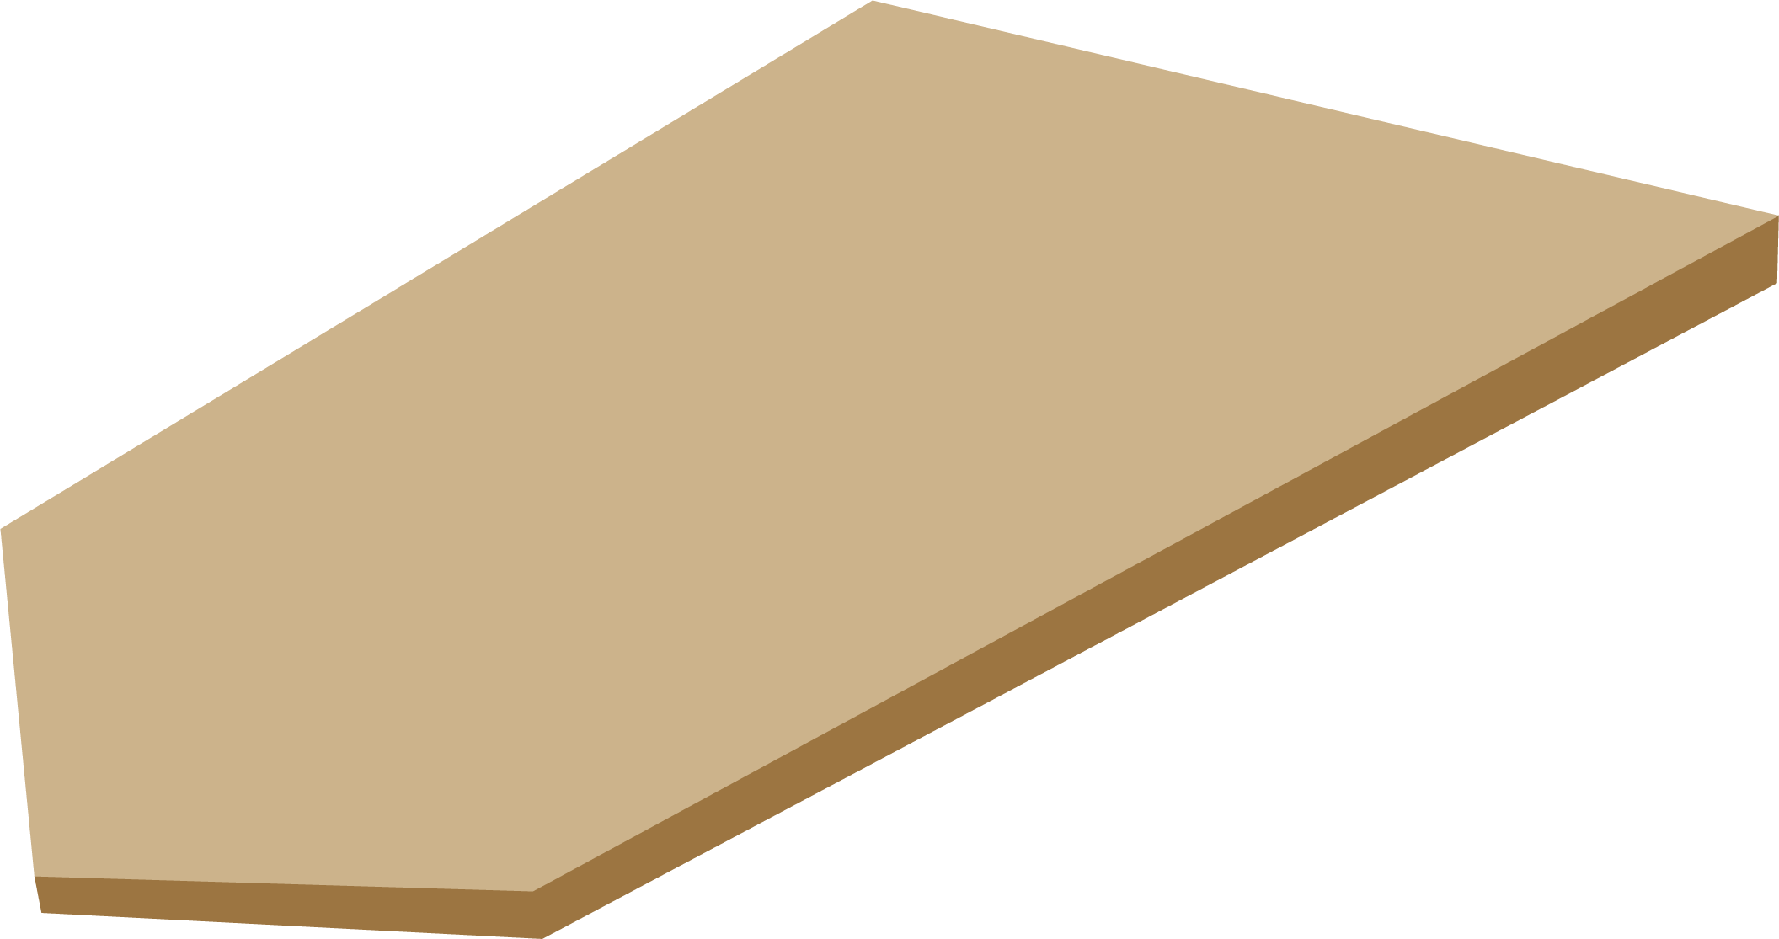
STAGE 1: Wet Work
Wet Work is when clay is moist and pliable.
CLAY PARTICLE
A clay particle is one-hundred times longer than it is thick.
Notes:
Wet work is when clay is moist and pliable.
Plastic or plasticity is a term used by potters that refers to the malleability of clay.
This is an illustration of a clay particle. The reason clay is sticky, plastic and malleable is because of this sediment construction. For example, you can’t make a pinch pot from wet beach sand because the particles are a different shape and don’t stick together.

Slide 6
STAGE 1: Wet Work cont.
Water trapped between clay particles
clay particle
Water allows clay particles to move easily AND be molded into any shape you want!
Notes:
In this illustration there are clay particles stacked up like a deck of cards. Clay particles are flat and thin and have the capacity to trap water particles between them. Water particles act as ball bearings allowing clay particles to easily slide and move.
Think about telling a story: You and Harvey go outside to play cards. A heavy rain soaks the table, chair, you, Harvey, and the deck of cards. As you try to separate the individual cards from the soggy deck, the plasticity of clay is illustrated. The water particles trapped between the cards create a slippery adhesion. It is easier to slide them off the top of the deck than to peel them apart.

Slide 7
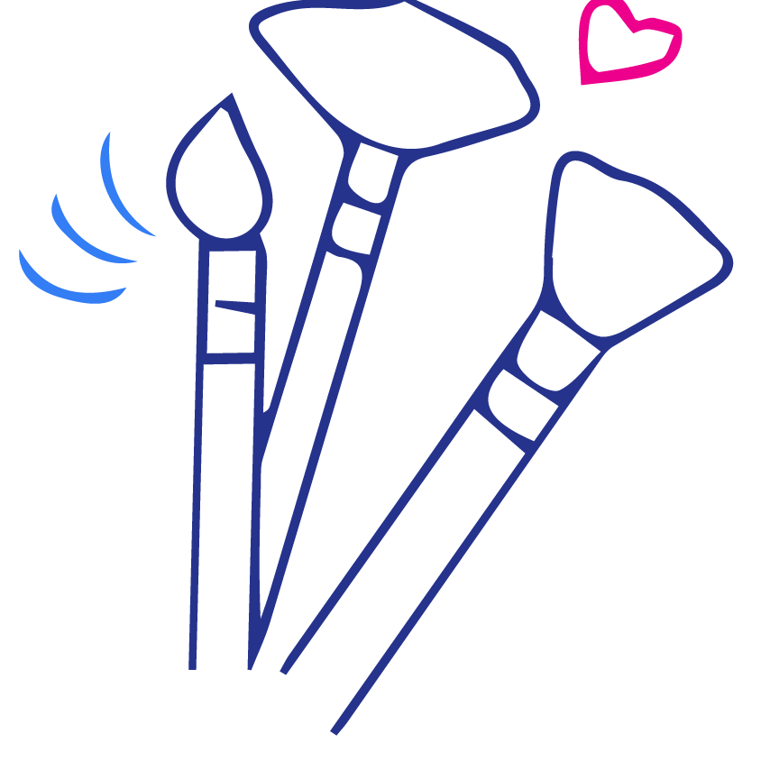
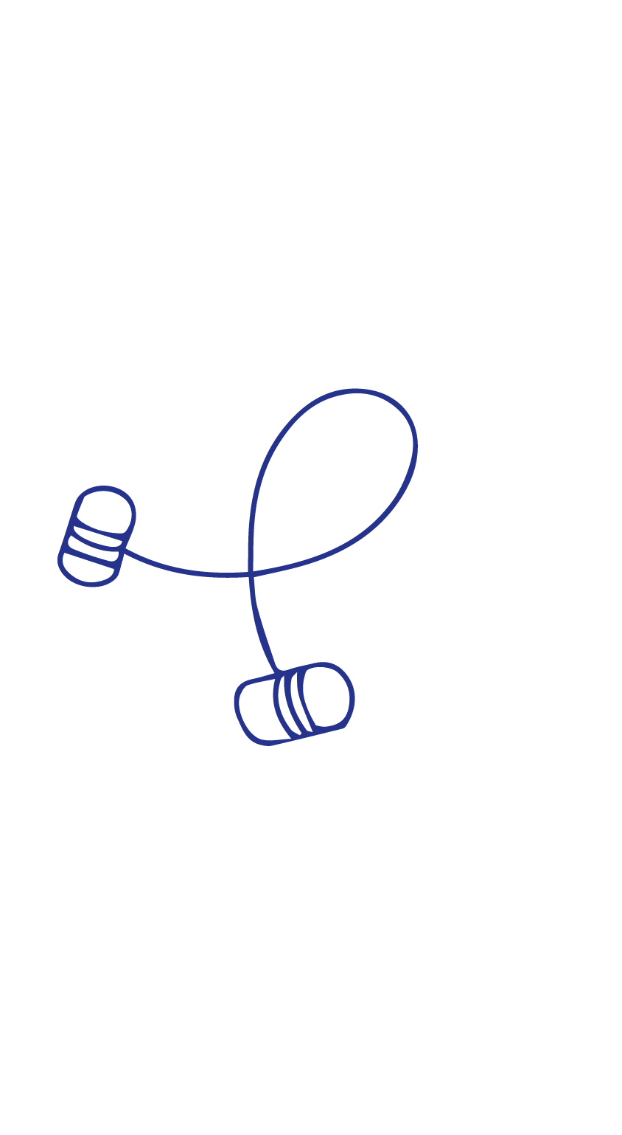
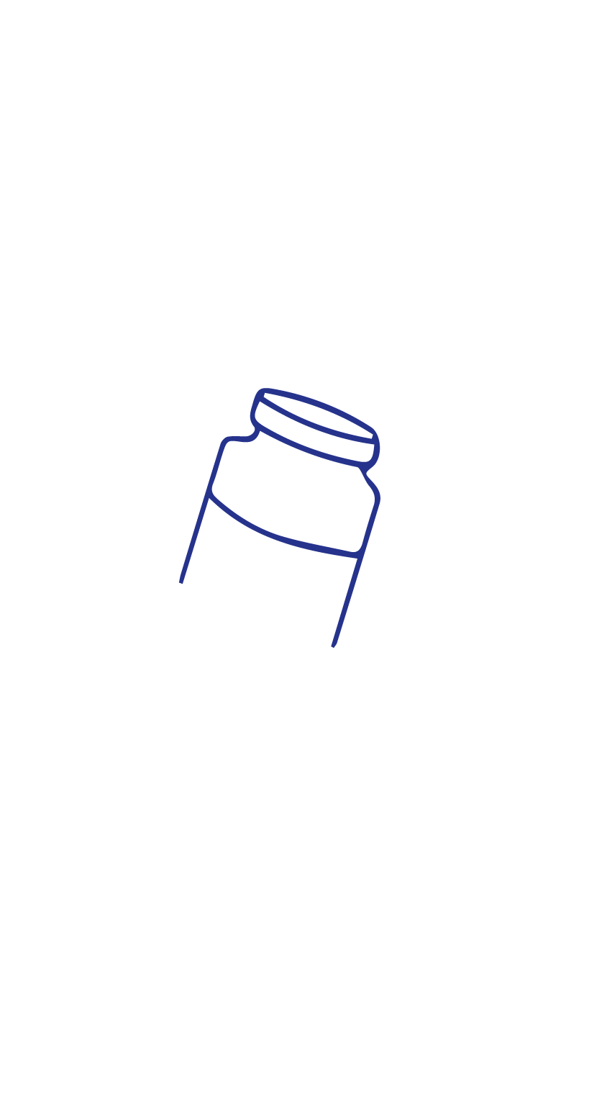
STAGE 2: Leather-hard
Clay is damp enough to:
- Join together
- Carve
- Paint with underglazes
Notes:
Leather-hard is the state of clay between wet and dry. Clay still contains moisture and is cool to the touch but can no longer be formed or impressed with texture. This is the time to join clay parts together, and carve and paint with underglazes.
The term leather-hard comes from leather. A leather belt is stiff enough to hold its shape and can also bend.
Underglazes can be applied at any stage from leather-hard to bone dry.

Slide 8
STAGE 3: Bone Dry
Clay shrinks and is VERY brittle
Why does clay shrink?
Notes:
Bone Dry clay is very brittle and breakable. Warning: the slightest tap can cause a project to break.
Clay shrinks twice, once in the bone dry stage and again when it’s fired. Clay shrinkage can vary from five to fifteen percent depending on the type of clay and firing. When firing earthenware in the classroom, shrinkage is usually not noticeable.
Why does clay shrink? The water that acts as ball bearings, making the clay malleable, is now evaporated, and particles move closer together.

Slide 9
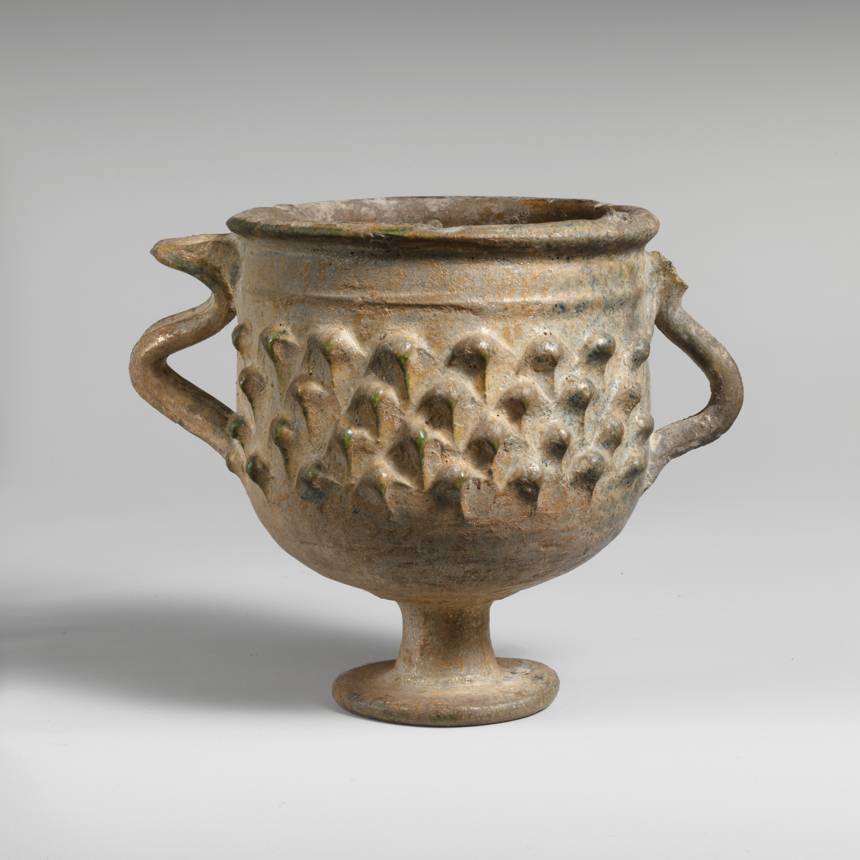
STAGE 3: Bone Dry cont.
. . . And who cares if clay shrinks ?
- smaller parts, such as handles, may crack
“Lead-Glazed Stemmed Cup: Roman, Late Imperial, 3rd Century A.D.” The Metropolitan Museum of Art, www.metmuseum.org.
Notes:
Why should students care about shrinkage that is not noticeable in low earthenware firings?
When water within the clay body evaporates at different rates, smaller clay parts--such as handles-- may crack.
Hint: Try wrapping a strip of plastic around the handle to slow the drying.
Side Story: Butch the Roman potter is busy in his studio when summoned by the Commander. The Commander tells Butch that they are going on a campaign to Gaul (a.k.a. France) and they need cups as soon as possible to take with them. Butch goes back to the studio and informs everyone that they urgently need to make 200 cups. To speed up the process, Butch takes the finished cups out to dry in the hot Mediterranean sun only to discover later that all the handles cracked where they attach to the cup. Butch can’t figure out what went wrong. Chuck, a fellow potter, informs him that the cups dried too quickly, causing the handles to shrink away from the body of the cup.

Slide 10
STAGE 4: Bisque
Clay is fired in the KILN for the first time.
Once clay is fired, it is rock-hard and can never become slip again.
Notes:
Bisque firing is the first firing. Pottery fired once is called bisque-ware. After pottery is fired, it is rock-hard and has a dry matte finish. It is a good idea to show students an example of bisque-ware.
Projects need to be completely dry before loading into the kiln. Water that remains within the clay body will turn to steam that expands as the clay contracts, causing the work to break during firing.

Slide 11
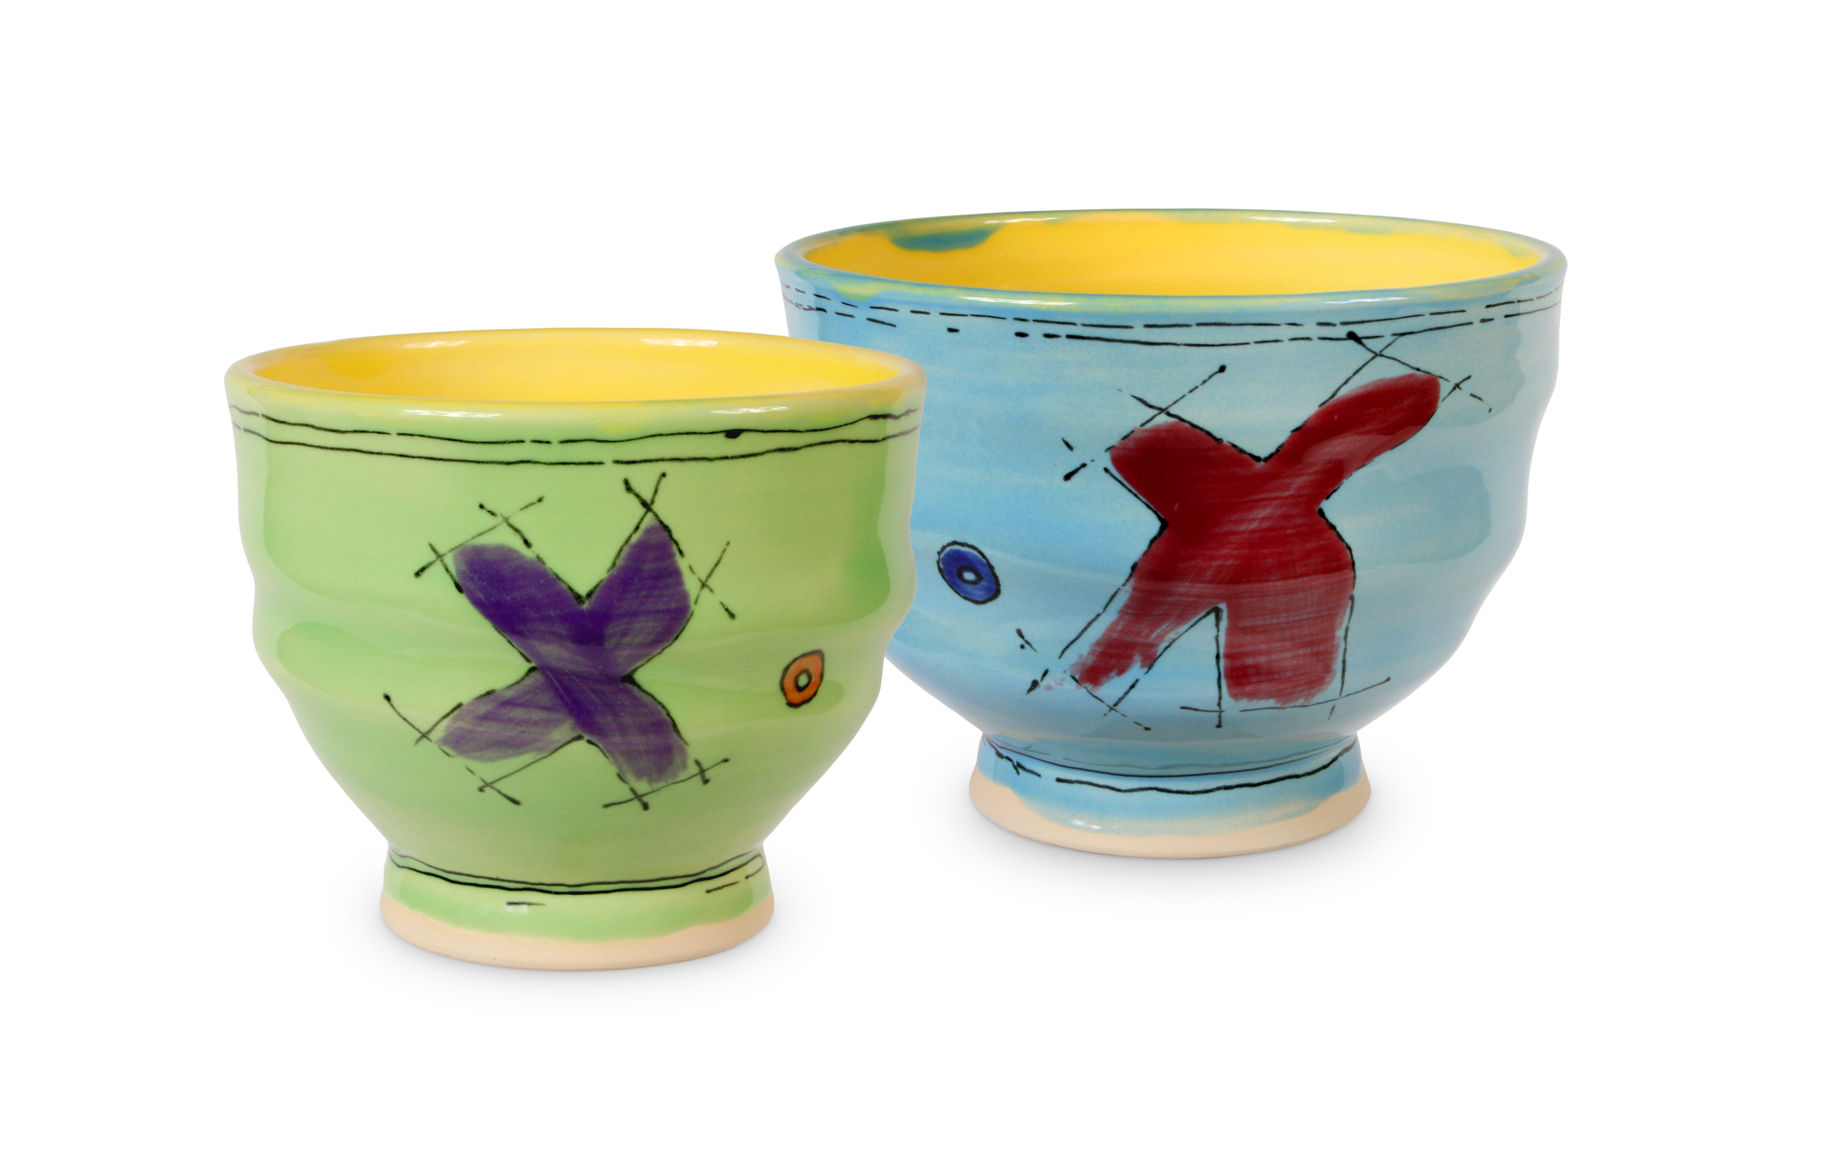
STAGE 5: Glaze
When glazed pottery is fired it becomes:
- Water tight
- Shiny & Colorful
AMACO Teacher’s Palette glazes were used on these pieces
Notes:
Glaze is a glass-like coating that is brushed onto bisque-ware before it is fired a second time.
Glazing pottery makes it water-tight and adds color and beauty.

Slide 12
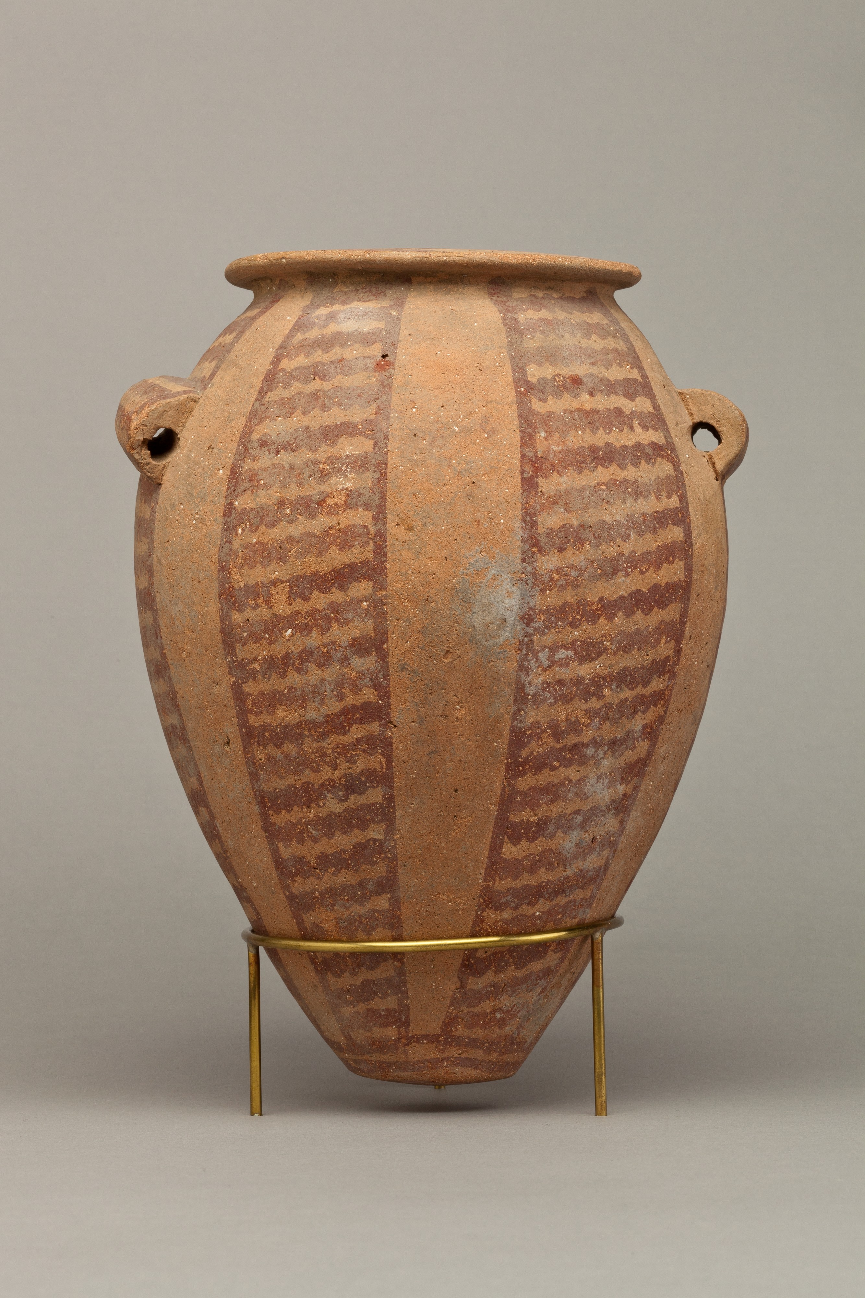
STAGE 5: Glaze cont.
Why were many Egyptian pots left unglazed?
- The technology did not exist
- Refrigeration through evaporation
“Decorated Ware Jar with Vertical Bands of Wavy Lines: Egyptian Art, Predynastic Period
ca. 3850-2960 B.C.” The Metropolitan Museum of Art, www.metmuseum.org.
Notes:
Ancient Egyptian pottery was not always glazed because the Egyptians didn’t have the technology to build high-fire kilns. Though they were prolific with glass, glaze or glass coating was rarely used on pottery. Once glaze was in use, unfortunately it was made from lead.
Egyptians found that by leaving fired pottery unglazed, water slowly evaporated through the walls, cooling the remaining moisture inside. Refrigeration through evaporation.
Side Story
What’s the problem with eating off of non-glazed bisque ware?
Momma Egyptian called to her son Johnny telling him breakfast was ready. Johnny bounded down the stairs excited about the upcoming day at Ramses High School. Johnny’s mom ladled a heaping scoop of scrambled eggs onto Johnny’s bisque breakfast plate. As Johnny ate his breakfast he realized that moisture from his scrambled eggs was leaching into the plate. Soon, he felt unwell. Why? Because the moisture absorbed by the bisque-ware formed bacteria. Momma Egyptian went shopping at the Papyrus Market and found this jewel-like glazed plate perfect for Johnny’s breakfast. The good news is that it wasn’t absorbent because it was glazed. The bad news is that lead was the major component in the glaze.

